Slide 1
ASSISTIVE HARDWARE INITIATIVE · OPEN SOURCE
BrailleBridge
Student 1
Writes in Braille Using the Keyboard
Student 2
Writes in Braille Using the Keyboard
Student 3
Writes in Braille Using the Keyboard
A $12 bilingual Braille writing system: the student writes, the teacher reads.
Engineered for seamless classroom examination and live transcription across English and Bangla (Bharati Braille), eliminating single points of failure in inclusive education.
Bluetooth Receives & Translates the Braille Chords
Samin Yeasar
BMARPC
Class 8
https://solez.vercel.app
Teachers use the Custom Software to see the Readable Text Update and Written in Real time per Student with a One Click Export all Button
BILL OF MATERIALS
DUAL OUTPUT
LICENSING
BLE + USB
GNU GPL
v3
~$12 USD

Slide 2
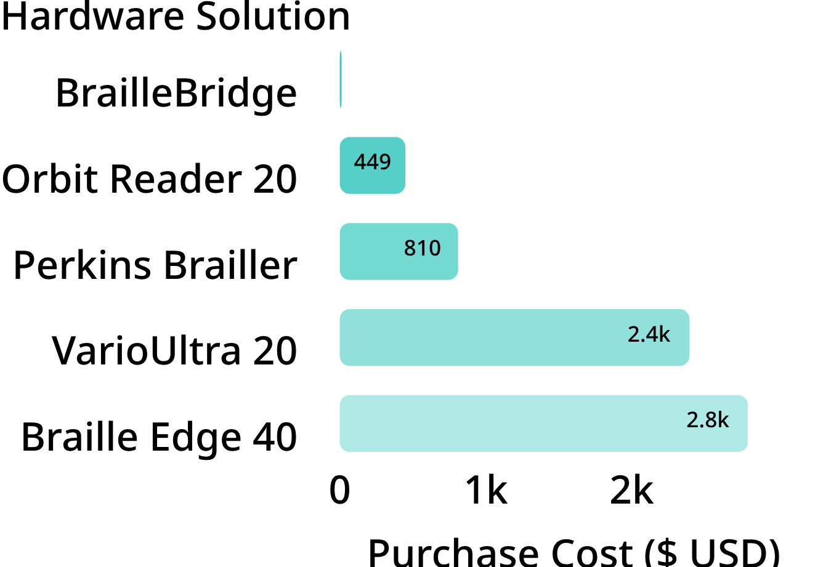
ASSISTIVE TECHNOLOGY LANDSCAPE
Compared with every alternative
Alternative | Primary Strength | Key Limitation | Cost ($)
Human Scribe | No hardware setup required | Privacy loss, spelling errors, scheduling risk | Recurring
Slate & Stylus | Extremely cheap & durable | Punctures paper, silent to teachers, tiring | $5–15
Perkins Brailler | Tactile mechanical gold standard | Heavy (5 kg), noisy, non-digital, costly | $810
Refreshable Display | Direct tactile output reading | Fragile piezo pins, unaffordable in dev. markets | $449–$2,795
Voice Typing / STT | Fast for casual conversational dictation | Hopeless in exams; fails on Bangla accents | Software
QWERTY + Screen Reader | Standard computer keyboard | 104-key hunting breaks Braille muscle memory | $20–$100
BrailleBridge | Bilingual chording, dual live output, light | Requires host screen for feedback reading | ~$12
HARDWARE CAPITAL COST (USD)
Sources: American Printing House, Perkins School for the Blind, Orbit Research.

Slide 3
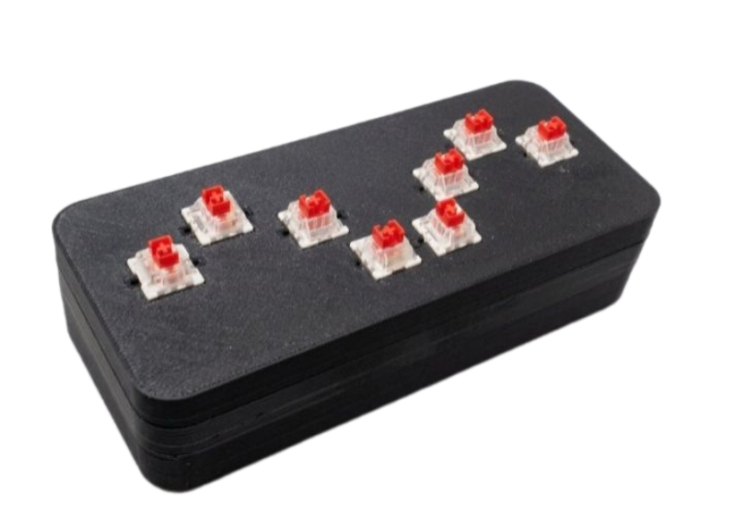
SYSTEM ARCHITECTURE & WORKFLOW
The student writes, the teacher reads
Specification | Production parameter
Input | 6 ergonomic dot keys + Space + Shift; Outemu Red linear switches; 180 ms chord window.
Hardware | ESP32 Dual-Core Tensilica LX6; onboard BLE & USB UART.
Languages | English Grade 1 Literary Braille + Bharati Braille (Bangla Unicode).
Interface | BLE HID to student audio reader; USB Serial to browser Teacher Software. Chrome/Edge Web Serial, UTF-8, zero-install, local storage.
Status | Prototype; about $12 parts; Apache 2.0.
From chord to classroom
Press a chord → translate to a 6-bit code → send by Bluetooth or USB serial → the teacher reads timestamped text.
Many students connect to one teacher; exam mode shows students side by side.

Slide 4
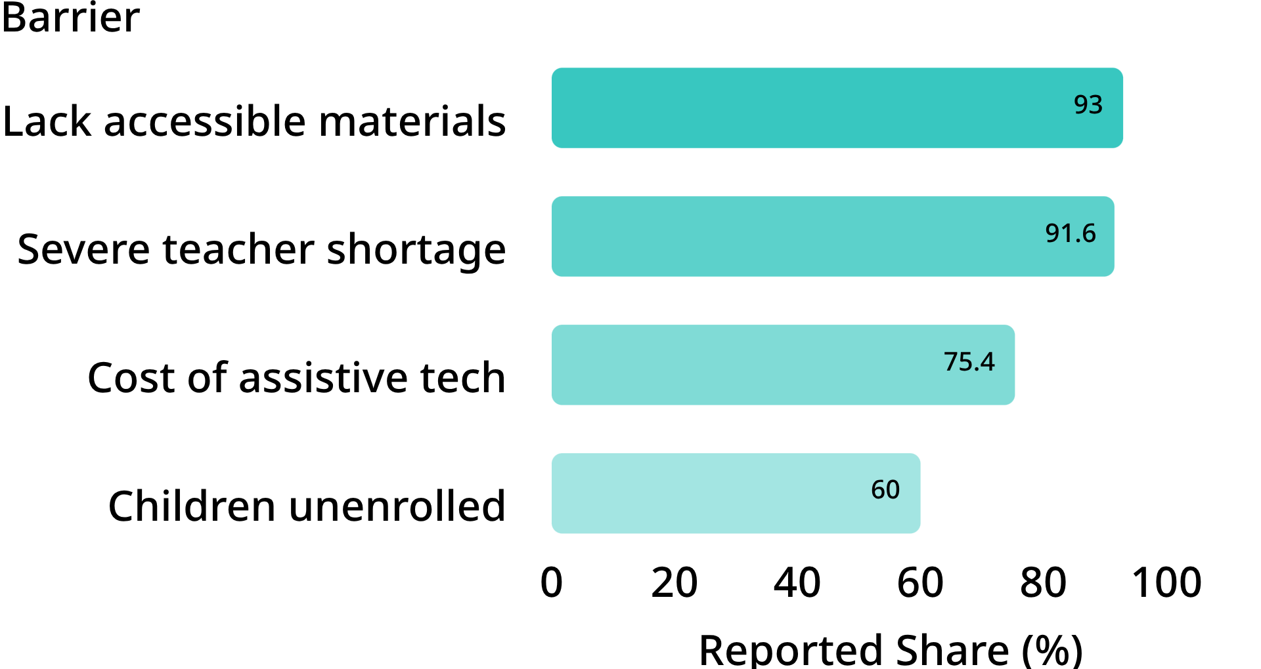
STRUCTURAL BARRIERS · BANGLADESH & GLOBAL
Silent answers are still answers
SURVEY EVIDENCE · VISUALLY IMPAIRED STUDENTS IN BANGLADESH
Visually impaired students routinely depend on sighted scribes during crucial board examinations. Privacy, autonomy, and pacing collapse, while technical terms and intricate Bangla spelling are routinely mis-transcribed.
Embossed Braille paper cannot be read by 90%+ of mainstream teachers, and imported 40-cell refreshable displays cost $1,499 to $3,695 (Tk 2 to 6 lakh). When scribes for seven Chattogram SSC candidates were rejected right before testing, their entire academic year hung on administrative discretion.
Data: Research field surveys on special educational needs; Braille textbook costs average ~3x standard print equivalents.

Slide 5

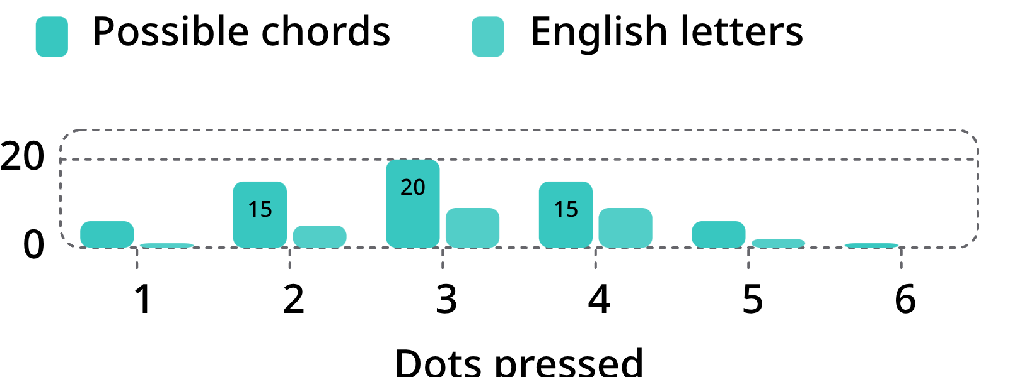
CHORDING ENGINE & LINGUISTICS
Chord math & bilingual typing
A 6-dot cell yields chords; four Shift and control layers offer up to 252 outputs. Dots 1+4 = 9 = c.
POSSIBLE CHORDS VS. ENGLISH LETTERS
TYPING বাংলা IN FIVE CHORDS
Grapheme | Braille chord
ব (ba) | Dots 1-2-3 · Bit 000111
Shift + া (aa-kar) | Shift + Dot 3-4-5 · Vowel Sign
ং (anusvara) | Dots 5-6 · Nasal Diacritic
ল (la) | Dots 1-2-3 · Liquid Consonant
া (aa-kar) | Dot 3-4-5 · Dependent Vowel
Window | Throughput
120 ms | 353 cpm
180 ms (shipped) | 261 cpm (~52 wpm)
250 ms | 200 cpm
Hold dots 4+5+6 for 500 ms to switch English Grade 1 and Bharati Bangla. Shift adds capitals, punctuation, digits, maths and dependent vowel signs (matras).

Slide 6
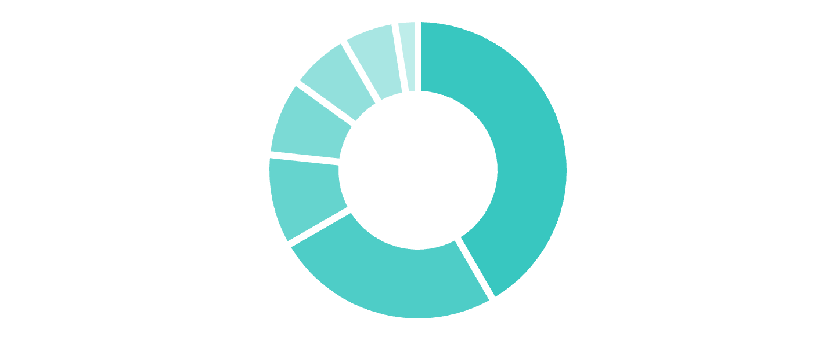
COMPONENT ARCHITECTURE
BOM ALLOCATION · $12 TOTAL
Hardware & connectivity
Bill of materials | Unit cost
ESP32 microcontroller | $5.00
8 Outemu Red switches | $3.00
3D-printed PLA enclosure | $1.20
Keycaps (8 units) | $1.00
Breadboard & PCB | $0.80
Screws & hookup wire | $0.70
LEDs & resistors | $0.30
Total hardware BOM | ~$12.00
TRI-CHANNEL OUTPUT
Channel | Protocol / receiver
BLE HID keyboard | ASCII · student phone / NVDA / TalkBack
BLE Nordic UART | Full NUS stream · class proctor app
USB serial | 115200 baud CDC · Teacher Web App
Excludes tools, labour and shipping. Off-the-shelf parts support local fabrication and repair in Bangladesh and Global South schools.
Teacher Software: Web Serial in Chrome or Edge; UTF-8 safe for Bangla, local-only storage and text export.

Slide 7
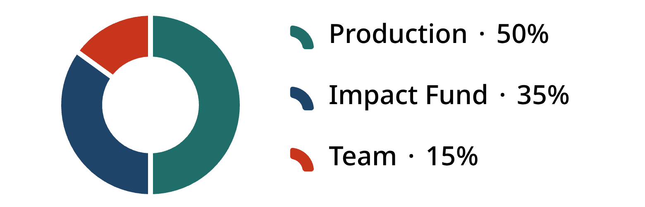
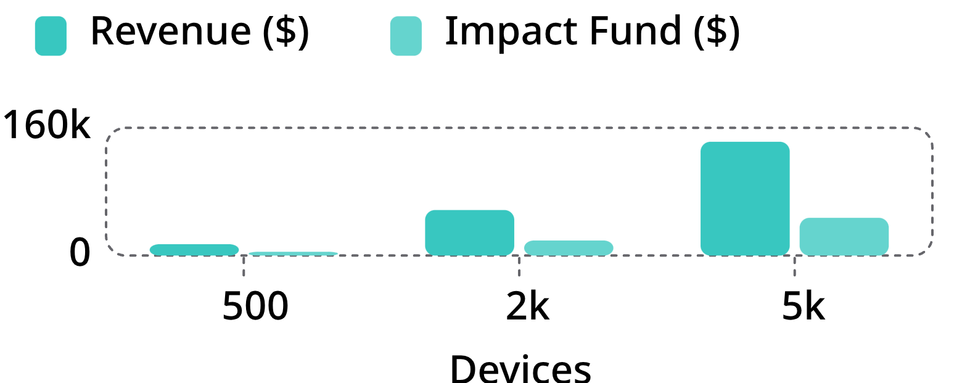
Business model: buy to give
City schools pay $30 per device; 70% of surplus funds NGO deliveries to rural schools, 30% goes to the team.
THE $30 SPLIT & PACKS
PRODUCTION VOLUME VS. IMPACT FUND
Pack | Price | Free funded
Solo (1x) | $30 | 0.5
Lab-5 (5x) | $150 | 2.6
School-10 | $285 | 4.7
District-25 | $675 | 10.5
Devices | Revenue | Fund | Free
500 | $14,250 | $4,725 | 236
2,000 | $57,000 | $18,900 | 945
5,000 | $142,500 | $47,250 | 2,362
Per unit: $30.00, $30.00, $28.50, $27.00. Split: $15.00 COGS/assembly; $10.50 Impact Fund; $4.50 team R&D.
Planning targets to test in a pilot: 12 sub-districts; National Division rollouts & Special Ed labs; regional South Asia NGO partner network. Source: BrailleBridge business model.

Slide 8
SCALE, RISKS & IMPLEMENTATION
Impact, risks, roadmap and sources
Identified Risk | Operational Threat | Engineered Mitigation Strategy
Exam Ban / Refusal | Boards reject unfamiliar digital input | Offline-only hardware lock switch; pre-exam board demo
Bangla Parser Glitches | Corrupted complex conjuncts (যুক্তবর্ণ) | Strict Bharati Braille Unicode lookups verified with teachers
BOM Cost Volatility | Chip spot prices rise above $15 | Drop-in pin-compatible RP2040 backup architecture
Hardware Breakdown | Rough handling in rural environments | Open STL 3D files for local snap-in switch replacement
Fund Misallocation | Subsidised units resold in cities | Serialised MAC tracking registered to vetted rural school codes
GLOBAL SCALE CONTEXT
2.2 Billion: WHO estimate of people with vision impairment globally, causing $411B annual productivity loss.
Bharati Standard: Hindi, Bengali, Tamil and Urdu share identical 6-dot Bharati mappings, enabling rapid regional expansion.
10% Braille Literacy: NFB reports only ~10% of blind US children learn Braille today, driven by inaccessible hardware.
01
02
03
04
M 0–3: Pilot
M 3–6: Validate
M 6–9: Launch
M 9–18: Scale
30 units tested in Dhaka & Chattogram special education centers.
Board approval petitions & teacher software usability audits.
First 500 institutional packs sold; initial 236 free units deployed.
Expand Bharati language firmware across South Asian partner NGOs.
Sources: WHO World Report on Vision; The Business Standard; PMC8977819; Perkins School; NFB; Helen Keller Services; UNB; Open Repository.

Slide 9
FAQ: How is BrailleBridge different from a normal keyboard, and why can't we just raise the dots on the keyboard?
1. The Biomechanical Reality: "Searching" vs. "Chording"
2. The Phonetic Nightmare of Non-Latin Languages (Bangla & Bharati Braille)
"A normal keyboard requires a blind person to physically hunt and peck across 104 separate keys over a 45-centimeter surface area. Even with raised stickers, your fingers have to constantly wander, search, count rows, and re-orient home keys.
Braille does not work like QWERTY. Blind students are taught to write using chording—where all six fingers rest statically on the exact 6 dots of a Braille cell, exactly like playing notes on a piano or flute. Your hands never leave their position. You don't search for letters; your fingers press dot combinations simultaneously in a fraction of a second. BrailleBridge preserves that natural ergonomic muscle memory; a QWERTY keyboard destroys it."
"For standard English, maybe you could map A to A. But on a normal keyboard, how do you type complex phonetics like ক্ষ, ড়, ঞ, ং, or dependent vowel signs (কার/মাত্রা)?
In Bangla, standard typing systems (like Bijoy or Avro) require complex combinations of Latin letters, link keys (Hasanta 'g'), and modifier sequences that are visually designed for sighted people.
In contrast, blind Bengali students are already formally educated in the Bharati Braille standard, where every letter, conjunct, and diacritic has an exact, universal 6-dot cell. Sticking Braille on a QWERTY keyboard doesn't solve the phonetic encoding problem; BrailleBridge's internal firmware directly translates native 6-dot Bharati Braille cells into valid Unicode digital Bangla in real time."

Slide 10
FAQ
4. Coordinated Dual-Output Architecture
"Lastly, a normal keyboard only plugs into one host. If you plug it into the student's laptop, the teacher standing at the front of the classroom cannot see what is being written in real time.
BrailleBridge is not just a keyboard; it is an integrated bilingual examination bridge. A single chord press simultaneously splits over two distinct channels: Bluetooth HID to the student's phone or tablet (so their screen reader reads it aloud in their ear), and USB Serial / Web Bluetooth streaming live to the sighted teacher's monitoring screen without requiring the teacher to ever learn a single dot of Braille.
Putting stickers on a normal keyboard gives you an awkward, slow keyboard. BrailleBridge gives a blind student true examination independence, dignity, and speed for a $12 bill of materials."
3. Examination Integrity & Cognitive Load
"In an examination hall, cognitive load is everything. When a sighted student takes a test, their eyes instantly dart across paper. If a blind student is forced to feel around a massive 104-key grid to find where a raised sticker is, their brain is wasting 70% of its energy on spatial searching rather than answering the math or science question.
With BrailleBridge, the form factor is a hand-held 8-key pad (6 dots + Space + Shift). It fits comfortably on tiny school desks, requires zero wrist movement, and operates identically to traditional Perkins Braillers that schools already train students on."

